Slide 1
NEUROSCIENCE: SYNAPTIC TRANSMISSION

Slide 2
WHAT ARE THE PARTS OF A NEURON?
Cell Body/Soma
Dendrites
Axon
Terminal Buttons/Axon Terminals

Slide 3
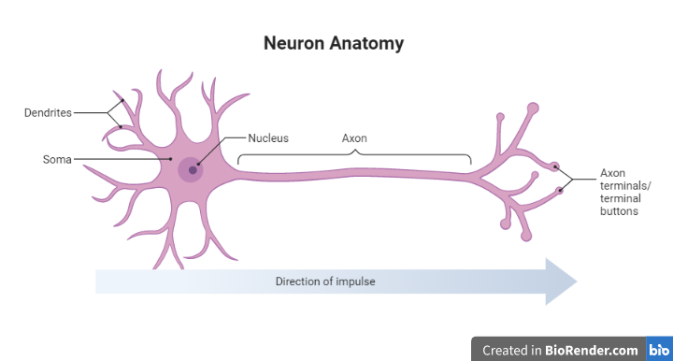
Brains are made of specialized cells called neurons which can transmit electrical and chemical signals to communicate about sensory input and motor output.

Slide 4
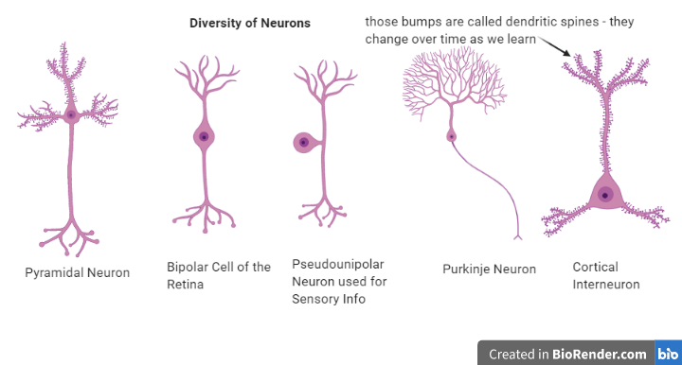
Different parts of the nervous system use different shapes of neurons to suit their purposes (form = function)

Slide 5
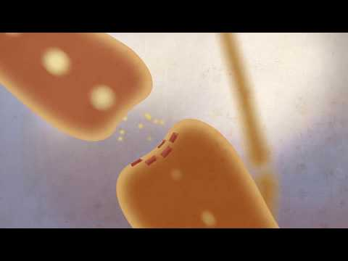

Slide 6
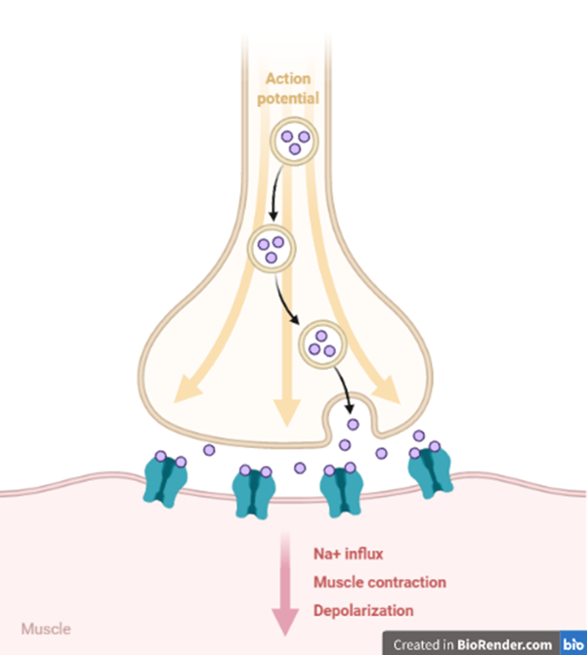
Notes:
Sensory inputs cause a rush of electrical signals to be sent along the axon. These electrical signals are called “action potentials”. At the terminal buttons, the action potential causes vesicles carrying chemical signals (neurotransmitters) to be released into the synapse, where they bind to receptors on the target cell. For example, sensory information comes into the brain, is integrated, processed, and motor output information is sent to muscles, making them contract.

Slide 7
dopamine (motor control, attention), serotonin (pain, stress, mood), epinephrine (fight or flight)
Brainstorm possible functions of these neurotransmitters in groups of 3-4: serotonin, dopamine, and epinephrine

Slide 8
Neurotransmitters are important communicators of different information. People can manipulate them to treat disease, addiction, and mental illness.
Why does this phenomena matter?
Tell me what you think!

Slide 9
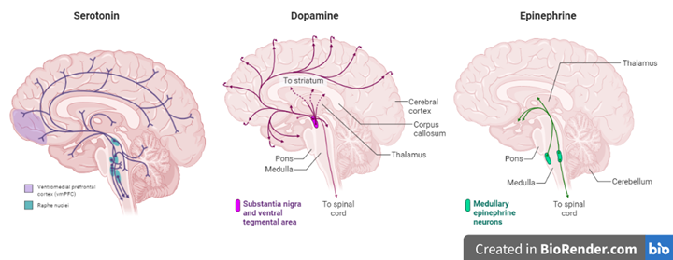
Match neurotransmitters to case studies by effect (think, pair, share)

Slide 10
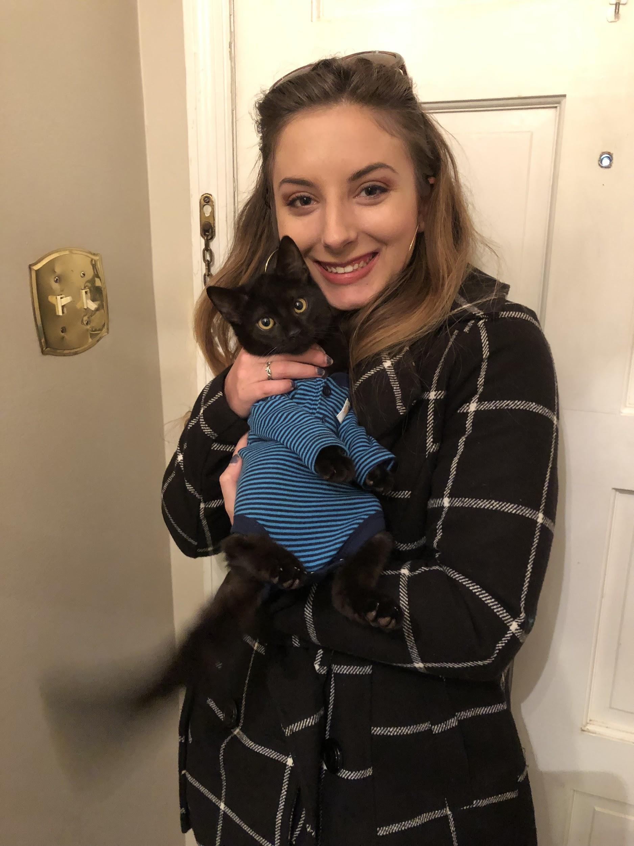
Meet the Scientist: Kendall Clay!
Kendall is a first year Neuroscience PhD student at the University of Georgia. She loves brains and studying how genes work together to control the brain’s many functions. In her free time, she likes to play guitar, embroider, and hang out with her cat!

Slide 11
Exit ticket: 3 things you learned, 2 things you liked, 1 question you still have

Slide 12
https://docs.google.com/document/d/1KEZLyKfqnVHvJzssHwhuFs2N-42GJZ4lqgg4m9KFvfQ/edit?usp=sharing
Case Study Link
https://docs.google.com/document/d/1OevoC6uQMVmUsWv-xqUMoWcGCDRcPbiSRTOeymfMzXQ/edit?usp=sharing
Quiz Link

